Slide 1

ML CLUB
Hands-On Workshop ML
Supervised Learning
[Week-3]
Gaurav Tiwari

Slide 2
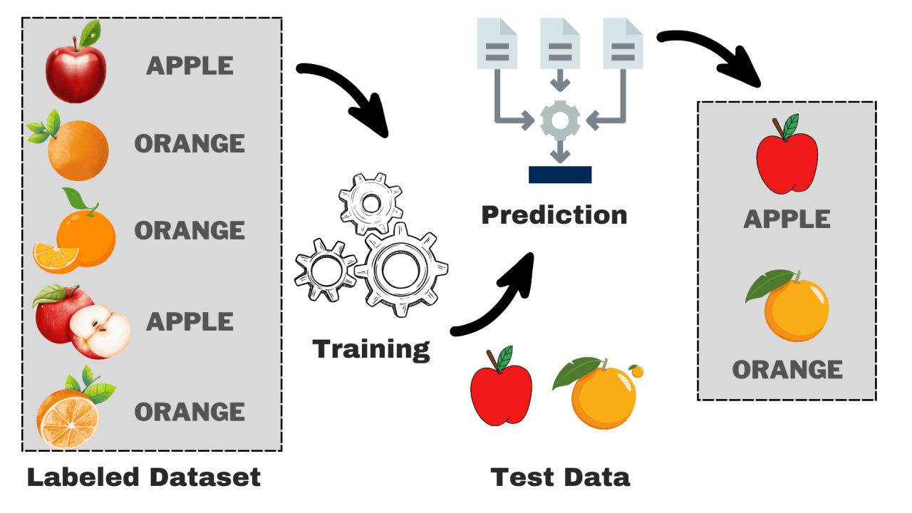
Supervised Machine Learning
Model is trained on Labelled Dataset
Provided input (X) – Provided output (y)
New input (x) – Predicted output?
Major Types:
Regression
Classification

Slide 3
Regression
Classification
Predicts a continuous numerical value based on input features.
Output (y) is continuous
Examples:
Predicting house prices from size & location.
Forecasting stock prices
Estimating temperature tomorrow
Common Models:
Linear Regression
Polynomial Regression
Decision Tree Regressor
Random Forest Regressor
Regression Metrics:
MSE
MAE
R²
Predicts a category/class label (discrete output) based on input features.
Output (Y) is discrete
Examples:
Email → Spam / Not Spam
Disease diagnosis → Positive / Negative
Common Models:
Logistic Regression
Decision Tree Classifier
Support Vector Machine (SVM)
k-Nearest Neighbors (kNN)
Classification Metrics:
Accuracy
Precision
Recall (Sensitivity)
F1 Score

Slide 4
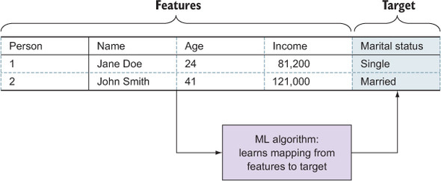
Features & Target
Features:
Properties which are analyzed by model to describe each instance.
Types:
Quantitative: height, no. of words in a text, no. of matches played, etc
Qualitative: blood-group, country-names, etc
Target:
Value to be predicted by model using the features.

Slide 5
General Flow
Data Collection
Data Preprocessing
Exploratory Data Analysis (EDA)
Training
Testing
Evaluation
Visualization
Improvement
* Work-flow may change according to the requirements

Slide 6
Underfitting
Major Issue
Overfitting
The model is too simple and fails to capture the underlying patterns in the data.
Reason:
Using too few features
Too simple algorithm (e.g., Linear Regression on non-linear data)
Not enough training
Signs:
High error on training set
High error on test set (both bad)
Example:
Predicting house prices using only number of rooms, ignoring location, size, etc.
The model is too complex and learns not only the patterns but also the noise in training data.
Reason:
Too many features
Very complex algorithm (deep trees, high-degree polynomials)
Not enough data / too small dataset
Signs:
Low error on training set (very good)
High error on test set (bad generalization)
Example:
A spam filter that memorizes specific training emails but fails to detect new spam with slightly different wording.

Slide 7
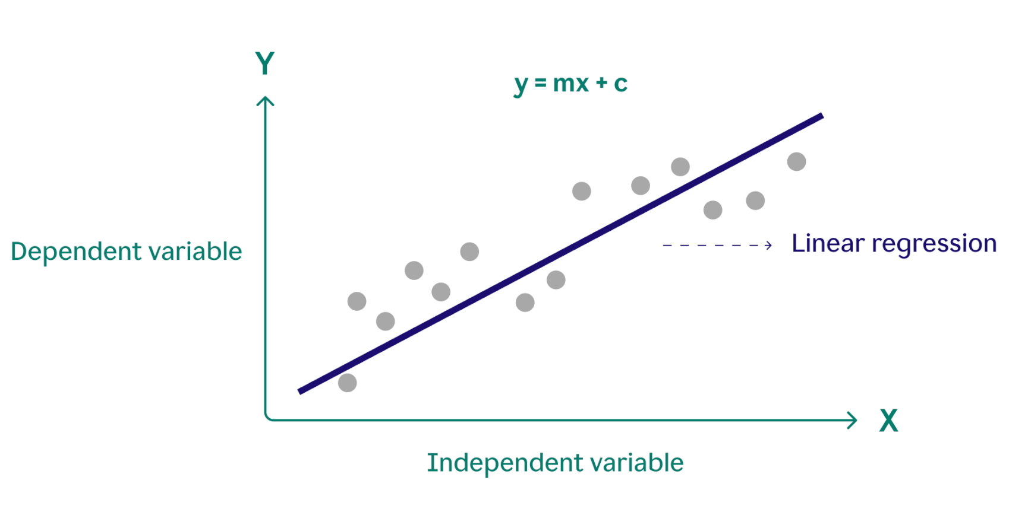
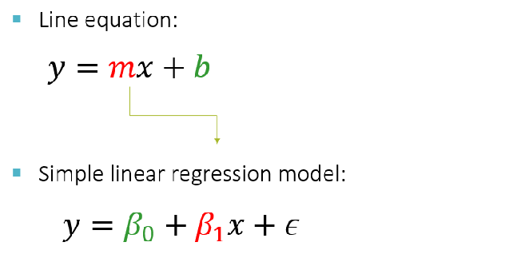
Linear Regression
Predicts value of dependent variable using dependent variable
Example:
Calculating BMI using height & weight.
Predicting house price using no. of rooms and other parameters.
y = Target (dependent variable)
x = Feature (Independent variable)
m = β₁ = Slope
b = β₀ = y-intercept
ε = Error

Slide 8
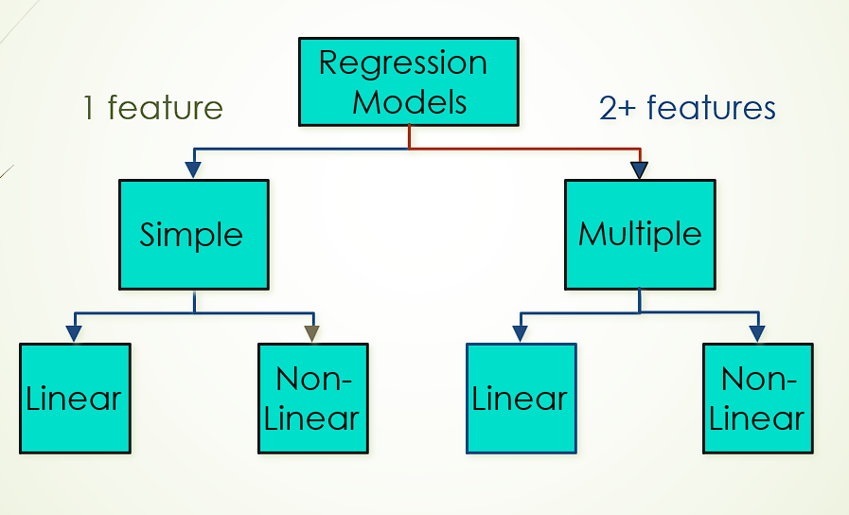

Linear Regression
Simple Linear Regression (only 1 feature – x):
Multiple Linear Regression (more than 1 features x1, x2, …):
β₀ is the intercept (i.e. the average value for Y if all the X’s are zero)
β_{j} is the slope for the jth variable X_{j}

Slide 9
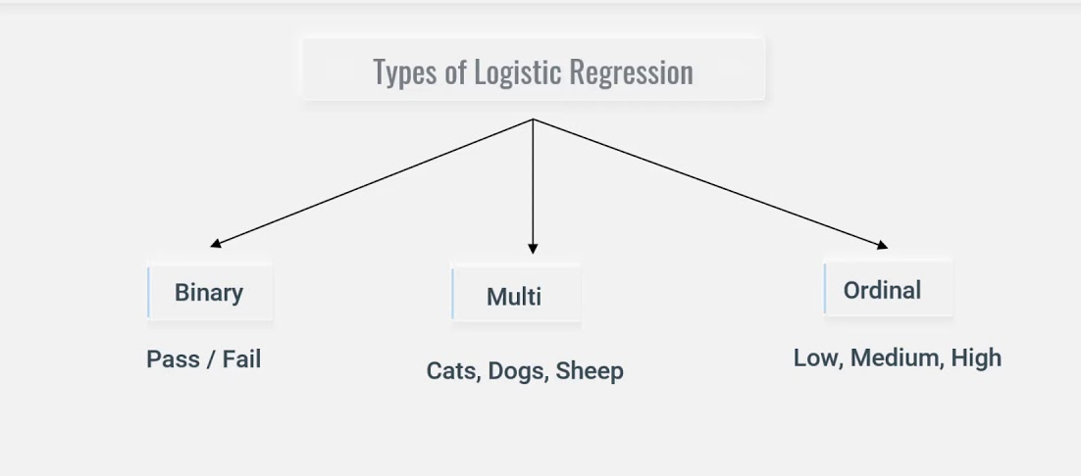
Logistic Regression
A type of supervised learning algorithm
Used for classification, not regression
Models the probability of class membership

Slide 10



Evaluation Metrics
Regression
Mean Absolute Error (MAE):
$$MAE=\frac{1}{n}\sum{∣}y_{i}−{\hat{y}}_{i}∣$$
Average of absolute errors
Lower MAE = better (Lowest = 0)
R-squared (R²):
$$R^{2}=1−\frac{SS_{res}}{SS_{tot}}$$
Measures how well the model explains variability in data.
Range:
1 = Perfectly Fit 0.90 = Excellent 0.75–0.90 = Good 0.50–0.75 = Fair < 0.50 = Poor 0 = Model is just as good as predicting the mean < 0 = Worse Than Mean
Mean Squared Error (MSE):
$$MAE=\frac{1}{n}\sum{(}{y_{i}−{\hat{y}}_{i})}^{2}$$
Average of squared errors
Like MAE but penalizes large errors more. Lower is better. (Lowest = 0)

Slide 11
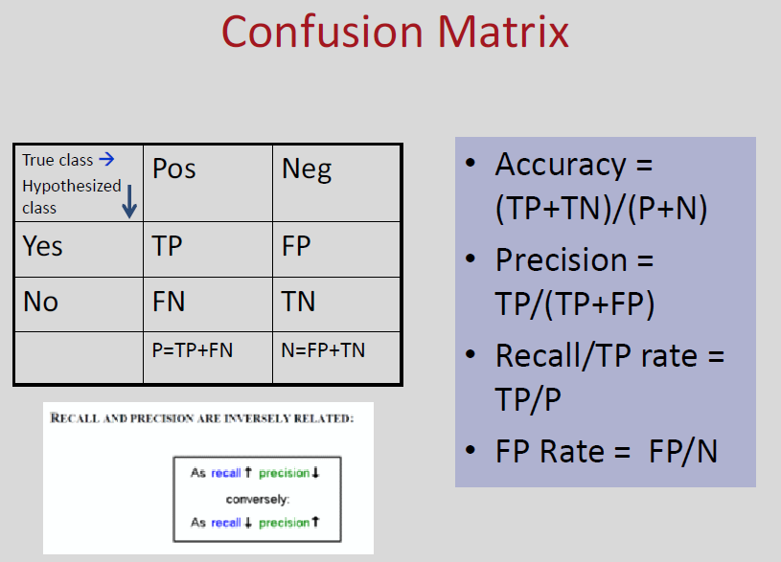




Evaluation Metrics
Classification
Accuracy:
$$\text{Accuracy} \text{=} \frac{\text{TP}\text{ + }\text{TN}}{\text{T}\text{P}\text{ + }\text{T}\text{N}\text{ + }\text{F}\text{P}\text{ + }\text{F}\text{N}\text{​}}$$
Overall correctness of model
Precision:
$$\text{Precision} \text{=} \frac{\text{TP}}{\text{T}\text{P} \text{+ }\text{F}\text{P}\text{​}}$$
Of all positive predictions, how many were actually correct
Recall/Sensitivity/TP rate:
$$\text{Recall} \text{=} \frac{\text{TP}}{\text{T}\text{P} \text{+ }\text{F}\text{N}\text{​}}$$
Of all actual positives, how many did the model detect
F1 Score:
$$\text{F}\text{1 }\text{=} \text{2 }(\frac{Precision . Recall}{Precision + Recall} )$$
Balance between precision and recall

Slide 12

Thankyou

